Slide 1



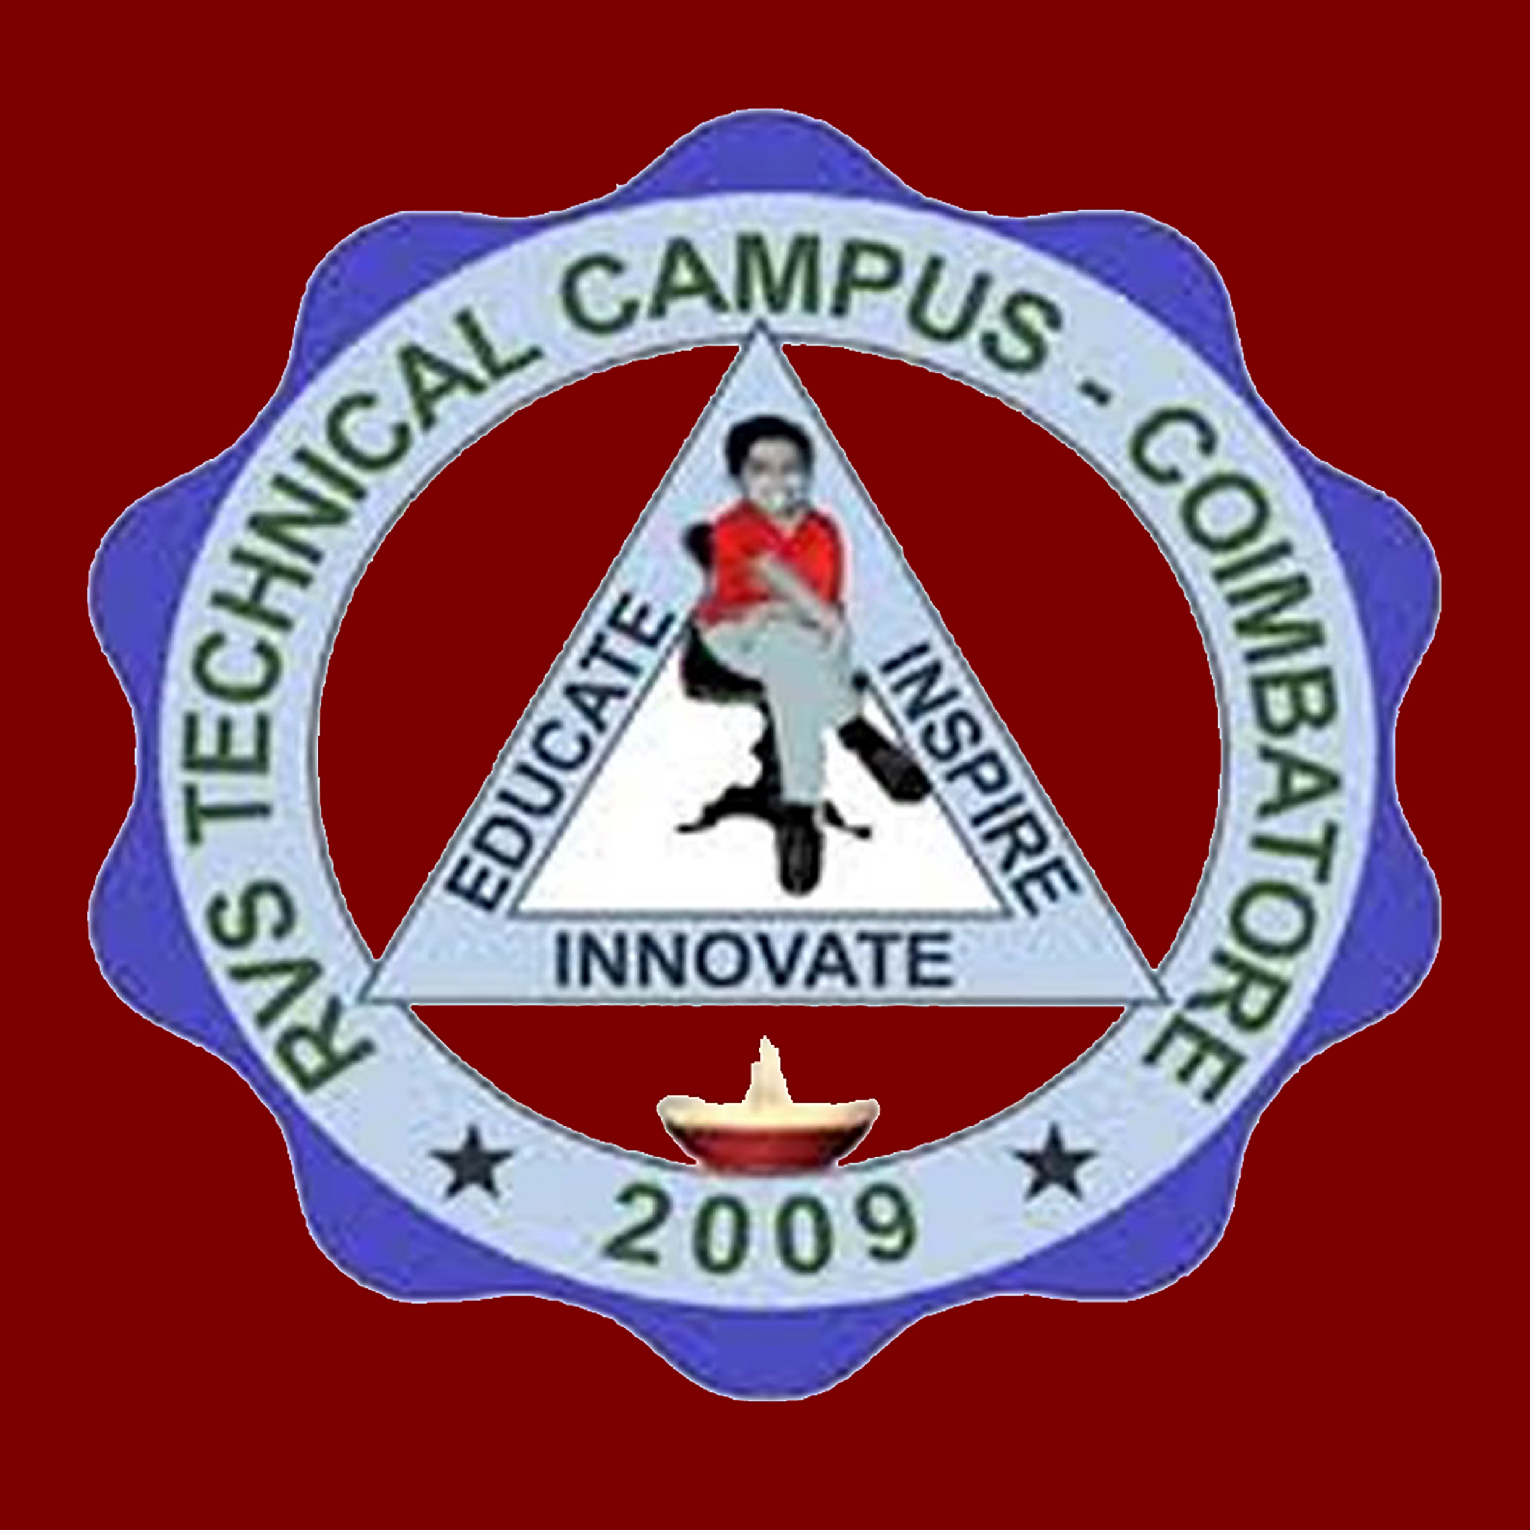
AI MODEL FOR AUTOMATED CONTENT MODERATION:INTERGRATING HUGGING FACE MODEL FOR TEXT AND IMAGE PROCESSING
ACCEPTANCE ID : ICECA-131
AUTHORS:
CHANDHRA NAIK, AKHIFA SHEIK,APOORVACHARAN KUMAR V
CHETHAN D B
DEPARTMENT OF CSE,
ALVA’S INSTITUTE OF ENGINEERING AND TECHNOLOGY,
MOODBIDRI,KARNATAKA,INDIA.
06/11/2025
ICECA-131

Slide 2

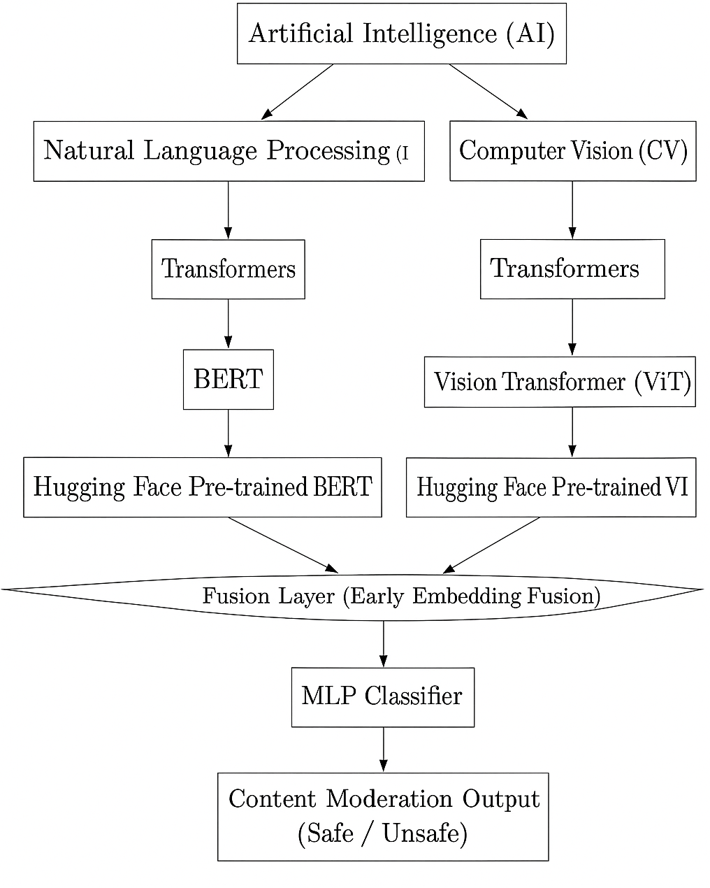
ALVA’S INSTITUTE OF ENGINEERING AND TECHNOLOGY
MIJAR, MOODBIDRI D.K. -574225 ,MANGALORE,KARNATAKA
INTRODUCTION
This project builds an AI-driven multimodal content moderation system for social media.
It integrates BERT (text) and Vision Transformer (images) with a fusion-based classifier.
The model detects toxic text, offensive memes, and unsafe imagery in real time.
Ensures scalable, fair, and explainable moderation for safe digital spaces.
ICECA-131

Slide 3
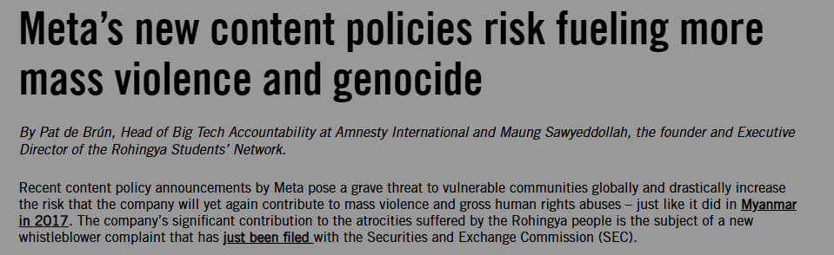
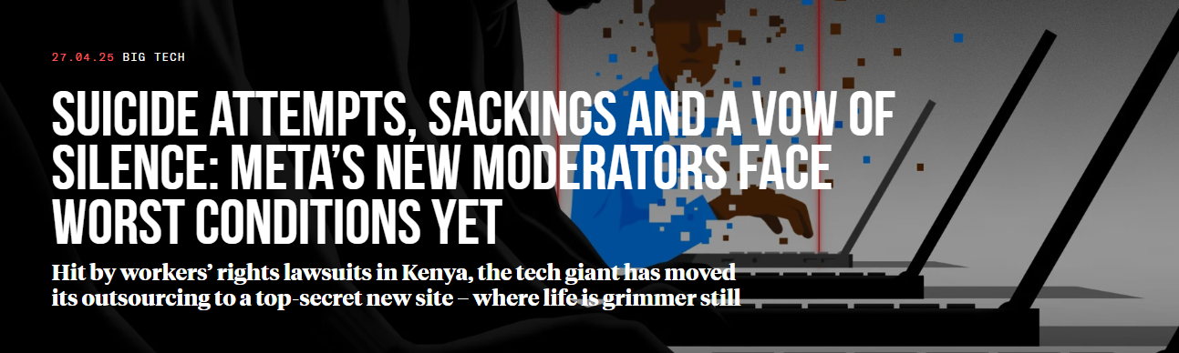
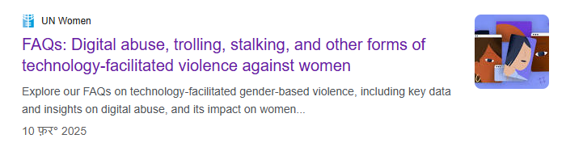
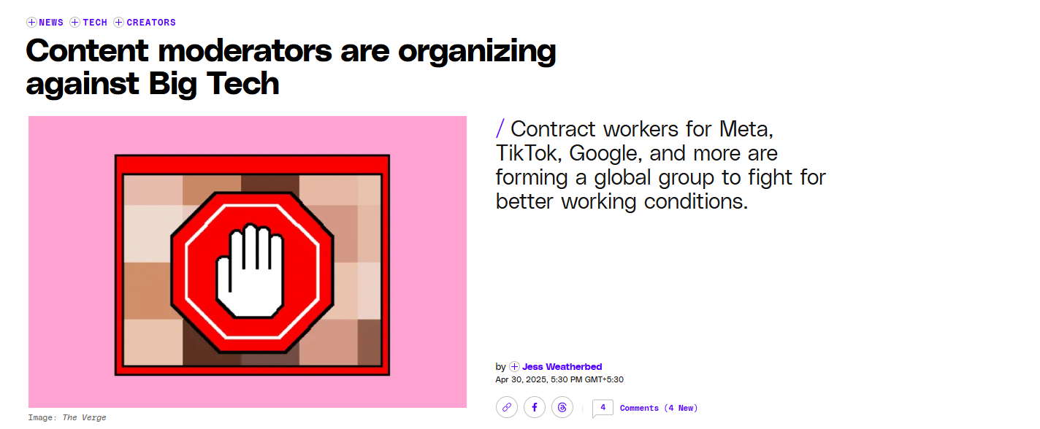
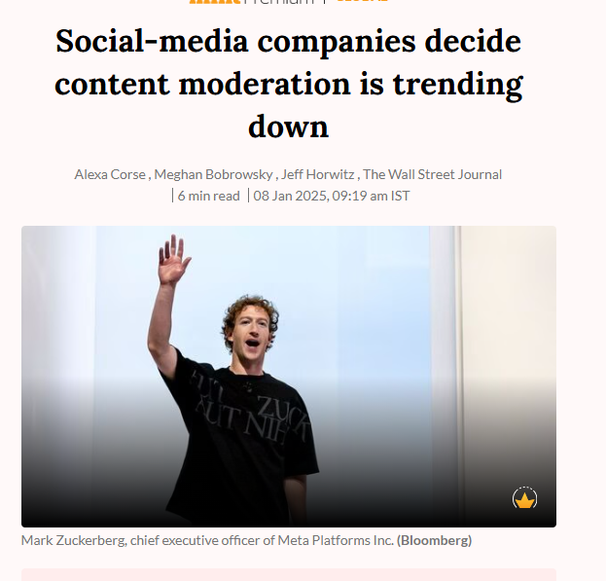
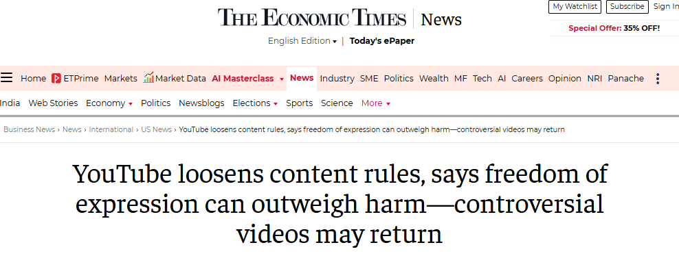
ALVA’S INSTITUTE OF ENGINEERING AND TECHNOLOGY
MIJAR, MOODBIDRI D.K. -574225 ,MANGALORE,KARNATAKA
PROJECT MOTIVATION
To develop a robust, scalable, and explainable multimodal content moderation framework by integrating Hugging Face pre-trained BERT and ViT models, achieving higher accuracy than unimodal baselines.
ICECA-131

Slide 4
ALVA’S INSTITUTE OF ENGINEERING AND TECHNOLOGY
MIJAR, MOODBIDRI D.K. -574225 ,MANGALORE,KARNATAKA
PROJECT MOTIVATION
Problem in Focus:
The exponential rise of user-generated content on social media brings offensive text, toxic memes, and unsafe images.
Manual moderation is time-consuming, biased, and non-scalable.
Need for Automation:
Platforms require real-time, scalable, and objective moderation systems.
Existing unimodal approaches (text-only or image-only) often fail in detecting multimodal content such as memes.
ICECA-131

Slide 5
ALVA’S INSTITUTE OF ENGINEERING AND TECHNOLOGY
MIJAR, MOODBIDRI D.K. -574225 ,MANGALORE,KARNATAKA
PROBLEM STATEMENT
The explosive growth of user-generated content on social media has led to the spread of offensive language, toxic memes, and unsafe imagery.
Manual moderation is slow, inconsistent, and biased, while unimodal AI approaches (text-only or image-only) often fail to detect multimodal content like memes that combine text with images.
Hence, there is a need for a multimodal, scalable, and explainable AI framework that integrates both textual and visual analysis for accurate and fair content moderation.
ICECA-131

Slide 6
ALVA’S INSTITUTE OF ENGINEERING AND TECHNOLOGY
MIJAR, MOODBIDRI D.K. -574225 ,MANGALORE,KARNATAKA
OBJECTIVES
Develop a multimodal content moderation framework: integrating Hugging Face BERT (text) and ViT (image) models.
Enhance detection accuracy: by applying early fusion of embeddings for joint reasoning over text and images.
Ensure scalability and reproducibility: using Hugging Face’s pre-trained and fine-tuned models.
Analyze classification errors: (false positives & false negatives) to refine the system for real-world deployment.
Address fairness and bias issues: by evaluating model behavior across diverse datasets and cultural contexts.
ICECA-131

Slide 7
ALVA’S INSTITUTE OF ENGINEERING AND TECHNOLOGY
MIJAR, MOODBIDRI D.K. -574225 ,MANGALORE,KARNATAKA
LITERATURE SURVEY
Paper Reference | Methods/Technique | Research Contributions | Research Gaps
[1] Hugging Face: Revolutionizing AI and NLP | Reviewed Hugging Face tools, libraries, and ecosystem for AI/NLP applications. | Showed how Hugging Face democratizes AI and accelerates model deployment. | Lacks experiments, performance benchmarks, and analysis of limitations or risks.
[2Automatic Report Generation for Histopathology Images Using Pre-Trained Vision Transformers and BERT | They used HIPT for image encoding and BERT for text generation. | They proved HIPT + BERT can generate reports effectively. | Accurate report generation needs stronger vision–language alignment, since simple fusion can miss critical image–text cues.
[3] Optimizing Multimodal Transformers for Medical Image Captioning: Enhancing Automated Descriptions via AI Systems | Used a multimodal transformer with attention to generate medical image captions. | Improved caption accuracy by integrating visual and textual features. | Limited generalization across modalities and real-world clinical settings.
ICECA-131

Slide 8
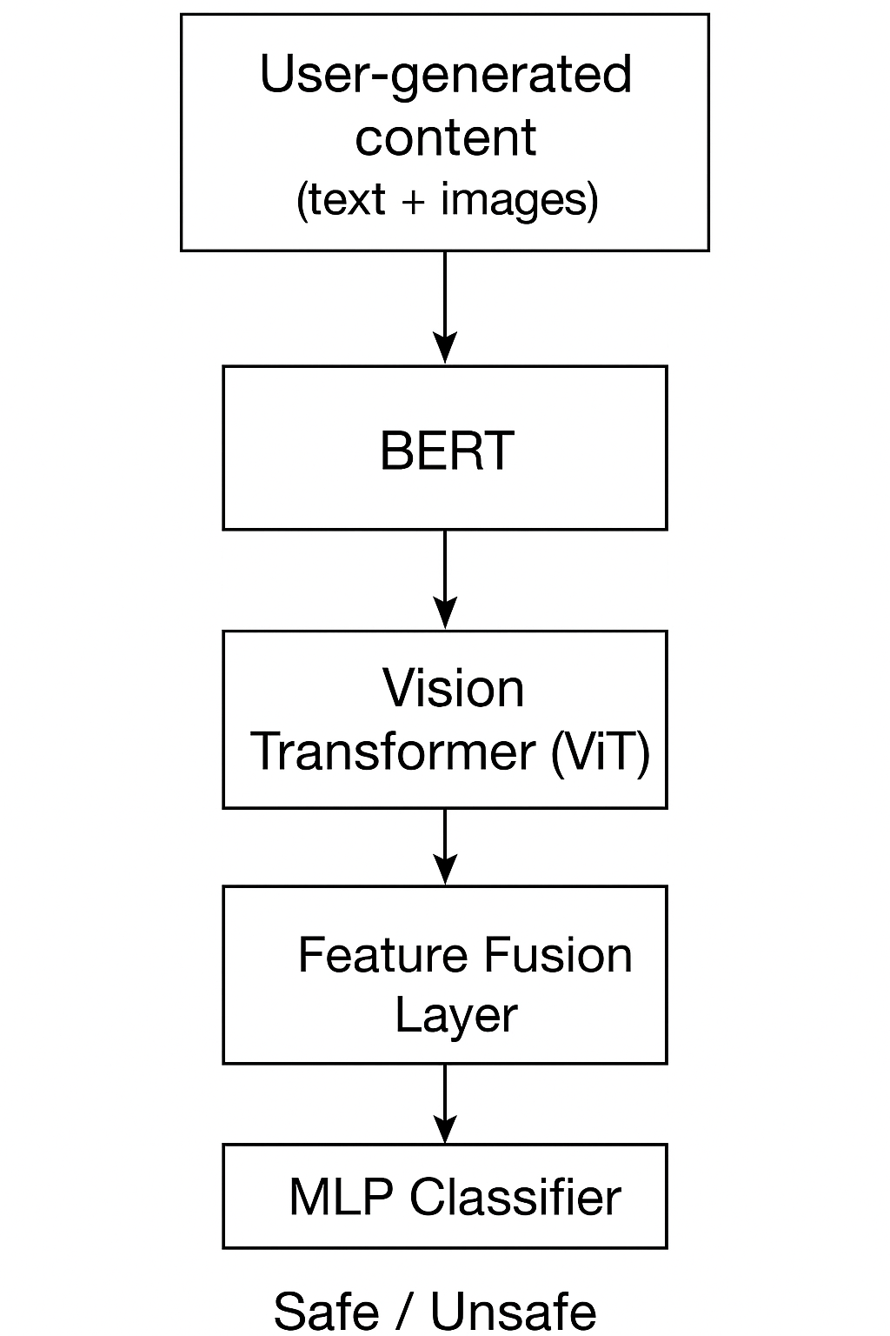
ALVA’S INSTITUTE OF ENGINEERING AND TECHNOLOGY
MIJAR, MOODBIDRI D.K. -574225 , MANGALORE,KARNATAKA
METHODOLOGY
The framework uses two parallel pipelines: BERT (for text analysis) and ViT (for image analysis).
Outputs from both pipelines are combined through an early fusion layer and passed to an MLP classifier.
Final system provides content moderation output (Safe / Unsafe) with improved accuracy compared to unimodal models.
ICECA-131

Slide 9
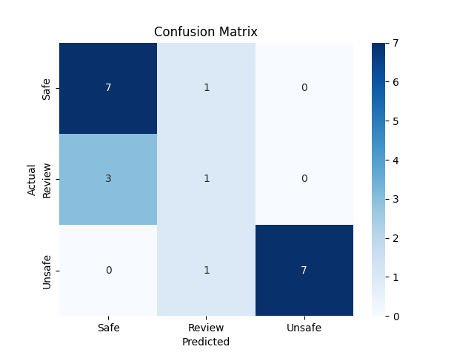
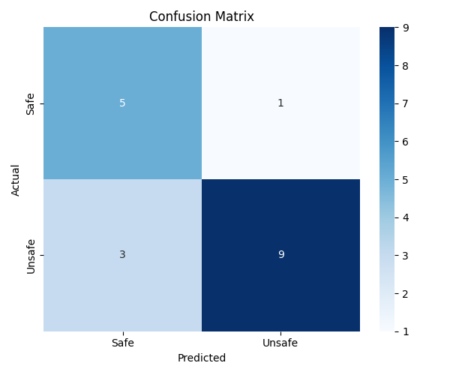
ALVA’S INSTITUTE OF ENGINEERING AND TECHNOLOGY
MIJAR, MOODBIDRI D.K. -574225 , MANGALORE,KARNATAKA
RESULTS AND DISCUSSION
Text
Image
ICECA-131

Slide 10
ALVA’S INSTITUTE OF ENGINEERING AND TECHNOLOGY
MIJAR, MOODBIDRI D.K. -574225 ,MANGALORE,KARNATAKA
PROJECT OUTCOMES
Improved detection performance compared to unimodal baselines, with higher accuracy, precision, recall, and F1-score.
Reduced classification errors, especially in sarcasm and meme-based content.
Technical Contribution: Demonstrated the effectiveness of Hugging Face multimodal fusion for safety-critical AI tasks.
Societal Impact: Supports safer and inclusive online communities by minimizing harmful, offensive, and policy-violating content.
Foundation for Future Research: Opens pathways for bias mitigation, multilingual support, and cross-modal attention techniques.
Department of CSE | Multi-model Content Moderation | 14

Slide 11
ALVA’S INSTITUTE OF ENGINEERING AND TECHNOLOGY
MIJAR, MOODBIDRI D.K. -574225 ,MANGALORE,KARNATAKA
REFERENCES
[1]A. R. Rao and A. Rao, “ASRtrans at SemEval-2022 Task 5: Transformerbased Models for Meme Classification,” Proc. 16th Int. Workshop on Semantic Evaluation (SemEval-2022), pp. 597–604, July 2022.
[2] K. J. Madukwe, X. Gao, and B. Xue, “A GA-Based Approach to FineTuning BERT for Hate Speech Detection,” 2020 IEEE Symposium Series on Computational Intelligence (SSCI), Canberra, Australia, pp. 2821–2828, Dec. 2020.
[3] S. Sengupta and D. E. Brown, “Automatic Report Generation for Histopathology Images Using Pre-Trained Vision Transformers and BERT,” 2024 IEEE International Symposium on Biomedical Imaging (ISBI), pp. 1063–1075, 2024.
[4] S. S. Sabry, T. Adewumi, N. Abid, G. Kovacs, F. Liwicki, and M. Li- ´ wicki, “HaT5: Hate Language Identification using Text-to-Text Transfer Transformer,” 2022 International Joint Conference on Neural Networks (IJCNN), pp. 1–8, 2022.
ICECA-131

Slide 12
ALVA’S INSTITUTE OF ENGINEERING AND TECHNOLOGY
MIJAR, MOODBIDRI D.K. -574225 ,MANGALORE,KARNATAKA
REFERENCES
[5]U. Pol, P. Vadar, and T. T. Moharekar, “Hugging Face Revolutionizing AI and NLP,” Int. J. for Research in Applied Science and Engineering Technology, vol. 12, no. 8, pp. 1–7, Aug. 2024. DOI: 10.22214/ijraset.2024.64023.
[6] T. Wolf et al., “Transformers: State-of-the-Art Natural Language Processing,” arXiv preprint arXiv:1910.03771, July 2020.
[7] M. Arman et al., “Optimizing Multimodal Transformers for Medical Image Captioning: Enhancing Automated Descriptions via AI Systems,” 2025 IEEE 6th Int. Conf. on Image Processing, Applications and Systems (IPAS), pp. 1–7, 2025.
[8]S. Agal et al., “Elevating Offensive Language Detection: CNN-GRU and BERT for Enhanced Hate Speech Identification,” Int. J. of Advanced Computer Science and Applications (IJACSA), vol. 15, no. 5, pp. 1–8, Jan. 2024. DOI: 10.14569/IJACSA.2024.01505118
ICECA-131

Slide 13
ALVA’S INSTITUTE OF ENGINEERING AND TECHNOLOGY
MIJAR, MOODBIDRI D.K. -574225 ,MANGALORE,KARNATAKA
REFERENCES
[9]P. N. Singh and S. Behera, “The Transformers’ Ability to Implement for Solving Intricacies of Language Processing,” 2022 2nd Asian Conference on Innovation in Technology (ASIANCON), Pune, India, pp. 1–6, Aug. 2022.
[10] N. Messina, F. Falchi, A. Esuli, and G. Amato, “Transformer Reasoning Network for Image-Text Matching and Retrieval,” Proc. 25th Int. Conf. on Pattern Recognition (ICPR), pp. 5222–5229, 2021
[11] Charan Kumar V., Darshan B., Chinmay Gowda, Lakshmi Prasad D. Yadav, and Charishma G., “AI Powered Multimodal Content Moderation for Online Safety in Social Media Platforms,” Proc. Int. Conf. on Computer Science and Engineering (IC-CSE), Alva’s Institute of Engineering and Technology, Moodbidri, India, 2025.
[12] M. Stappen, C. Koutlis, H. Muller, and B. Schuller, “A comprehensive ¨ survey on multimodal content moderation: Vision, language, and beyond,” Artificial Intelligence Review, vol. 58, no. 6, pp. 1–45, 2025, doi: 10.1007/s10462-025-11328-1.
ICECA-131

Slide 14
ALVA’S INSTITUTE OF ENGINEERING AND TECHNOLOGY
MIJAR, MOODBIDRI D.K. -574225 ,MANGALORE,KARNATAKA
CONCLUSION AND FUTURE SCOPE
Conclusion:
Built a multimodal moderation system (BERT + ViT) with Hugging Face.
Outperformed unimodal baselines in accuracy and F1-score.
Reduced false positives/negatives, improving reliability.
Future Scope:
Add cross-modal attention for better text–image reasoning.
Expand to multilingual and diverse datasets.
Apply fairness-aware training to reduce bias.
Enable real-time deployment on social media platforms.
ICECA-131

Slide 15
ALVA’S INSTITUTE OF ENGINEERING AND TECHNOLOGY
MIJAR, MOODBIDRI D.K. -574225 ,MANGALORE,KARNATAKA
THANK YOU!!

